Slide 1


HOTEL RESERVATION ANALYSIS
WITH SQL
INTRODUCTION
DATA CLEANING
IMPORTING FILES
PROBLEM STATEMENT
SQL QUERIES
CONCLUSION
B Y: ABDULSAMAD RAJI

Slide 2


INTRODUCTION
INTRODUCTION
DATA CLEANING
IMPORTING FILES
PROBLEM STATEMENT
SQL QUERIES
CONCLUSION
In hospitality, data serves as the cornerstone for strategic decision-making and enhancing guest satisfaction. This exploration delves into a hotel reservation dataset, aiming to uncover valuable insights regarding guest preferences, booking patterns, and pivotal elements influencing operational efficiency. Leveraging SQL for data querying and analysis, this endeavor targets specific inquiries, unraveling the intricate dynamics shaping the hotel industry's landscape.

Slide 3

DATA CLEANING
INTRODUCTION
DATA CLEANING
IMPORTING FILES
PROBLEM STATEMENT
SQL QUERIES
CONCLUSION
In the course of this presentation, we have proceeded to the pivotal stage of data cleaning. A key focus has been placed on standardizing the date column within the dataset, ensuring a uniform date format throughout all observations or rows. This meticulous step not only enhances data integrity but also establishes a reliable foundation for comprehensive analysis and interpretation, setting the stage for insightful insights into our data.

Slide 4
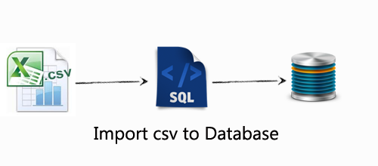
IMPORTING FILES
INTRODUCTION
DATA CLEANING
IMPORTING FILES
PROBLEM STATEMENT
SQL QUERIES
CONCLUSION
For this project, I've opted for PostgreSQL as my SQL Database Management System (DBMS). I started by setting up a dedicated database specifically for this project. Following that, I created a table mirroring the structure of my datasets, ensuring that the headers match exactly. Importing the CSV file into the SQL database was the next step, where I meticulously assigned appropriate data types for character strings, numbers, and dates. This methodical approach lays a strong foundation for seamless data handling and analysis within the PostgreSQL environment.

Slide 5
PROBLEM STATEMENT
INTRODUCTION
DATA CLEANING
IMPORTING FILES
PROBLEM STATEMENT
SQL QUERIES
CONCLUSION
1. What is the total number of reservations in the dataset?
2. Which meal plan is the most popular among guests?
3. What is the average price per room for reservations involving children?
4. How many reservations were made for the year 20XX (replace XX with the desired year)?
5. What is the most commonly booked room type?
6. How many reservations fall on a weekend (no_of_weekend_nights > 0)?
7. What is the highest and lowest lead time for reservations?
8. What is the most common market segment type for reservations?
9. How many reservations have a booking status of "Confirmed"?
10. What is the total number of adults and children across all reservations?
11. What is the average number of weekend nights for reservations involving children?
12. How many reservations were made in each month of the year?
13. What is the average number of nights (both weekend and weekday) spent by guests for each room
type?
14. For reservations involving children, what is the most common room type, and what is the average
price for that room type?
15. Find the market segment type that generates the highest average price per room.

Slide 6
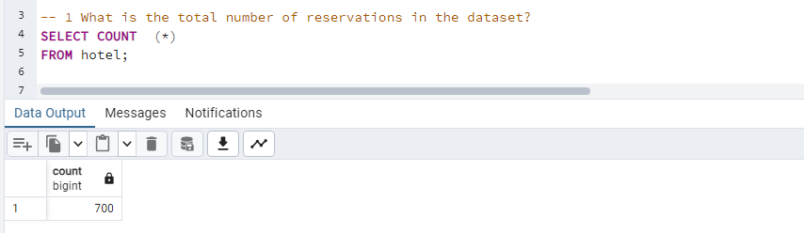
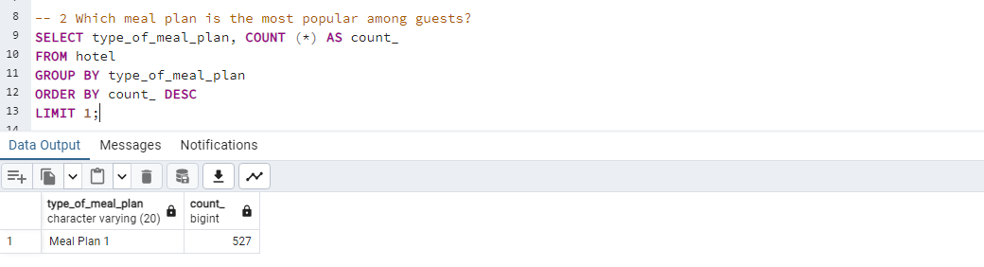
SQL QUERIES
INTRODUCTION
DATA CLEANING
IMPORTING FILES
PROBLEM STATEMENT
SQL QUERIES
CONCLUSION
1. What is the total number of reservations in the dataset?
2. Which meal plan is the most popular among guests?

Slide 7
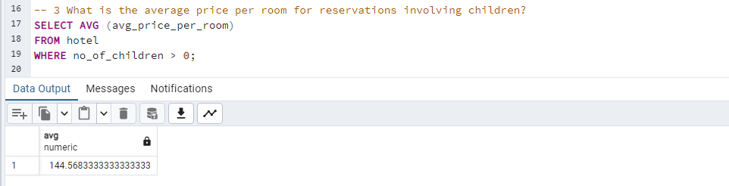
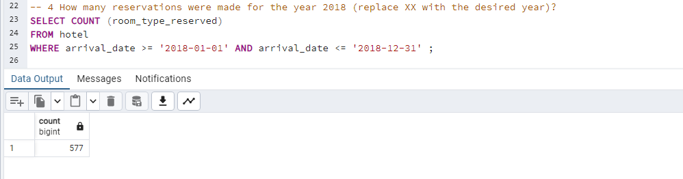
SQL QUERIES
INTRODUCTION
DATA CLEANING
IMPORTING FILES
PROBLEM STATEMENT
SQL QUERIES
CONCLUSION
3. What is the average price per room for reservations involving children?
4. How many reservations were made for the year 20XX (replace XX with the desired year)?

Slide 8
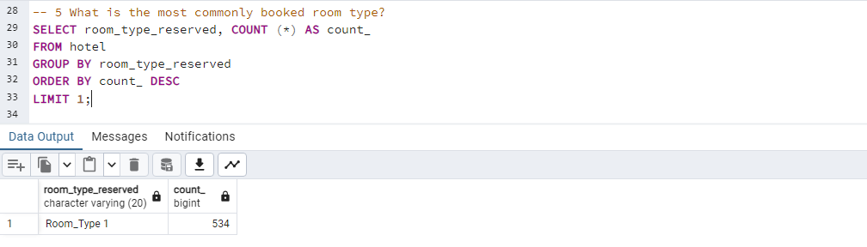
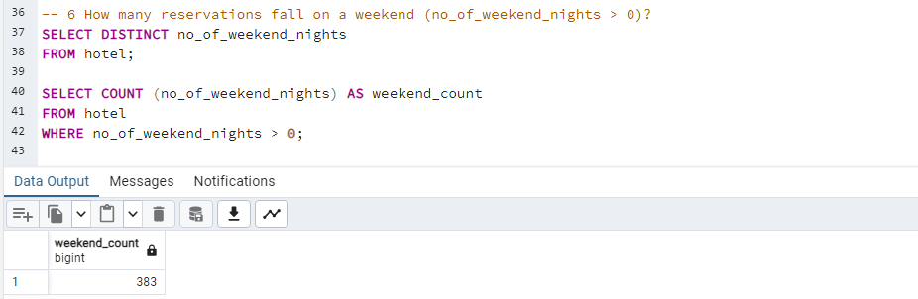
SQL QUERIES
INTRODUCTION
DATA CLEANING
IMPORTING FILES
PROBLEM STATEMENT
SQL QUERIES
CONCLUSION
5. What is the most commonly booked room type?
6. How many reservations fall on a weekend (no_of_weekend_nights > 0)?

Slide 9
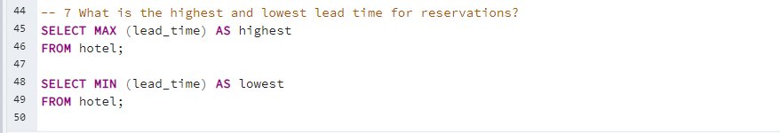


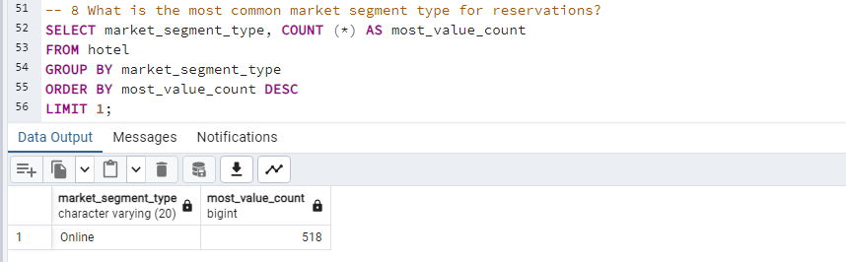
SQL QUERIES
INTRODUCTION
DATA CLEANING
IMPORTING FILES
PROBLEM STATEMENT
SQL QUERIES
CONCLUSION
7. What is the highest and lowest lead time for reservations?
8. What is the most common market segment type for reservations?

Slide 10
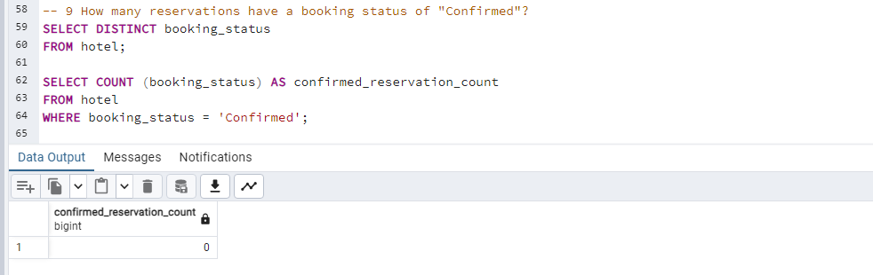
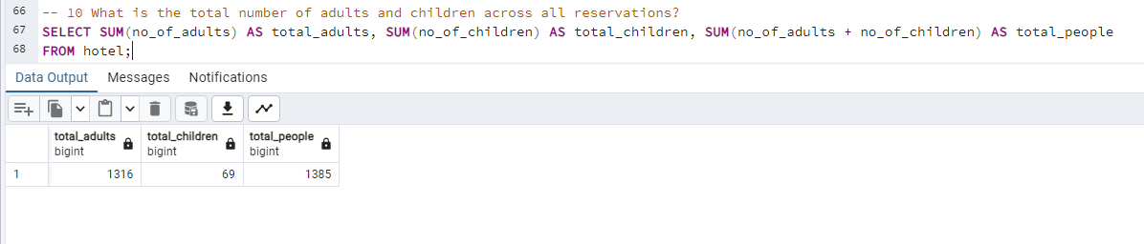
SQL QUERIES
INTRODUCTION
DATA CLEANING
IMPORTING FILES
PROBLEM STATEMENT
SQL QUERIES
CONCLUSION
9. How many reservations have a booking status of "Confirmed"?
10. What is the total number of adults and children across all reservations?

Slide 11
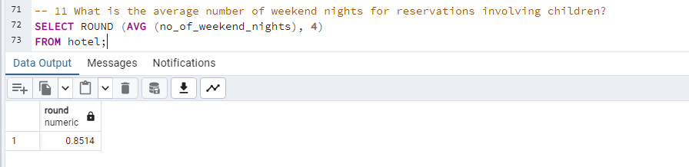
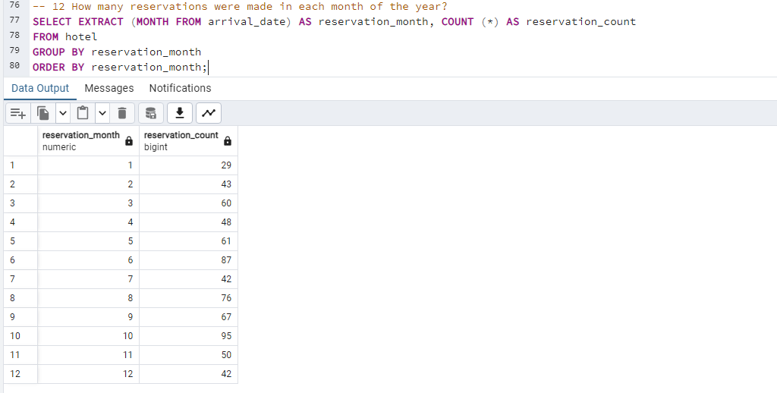
SQL QUERIES
INTRODUCTION
DATA CLEANING
IMPORTING FILES
PROBLEM STATEMENT
SQL QUERIES
CONCLUSION
11. What is the average number of weekend nights for reservations involving children?
12. How many reservations were made in each month of the year?

Slide 12
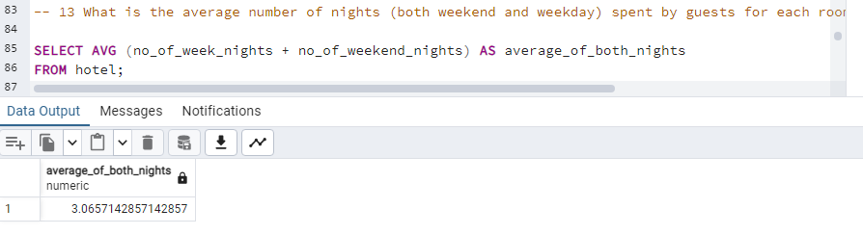
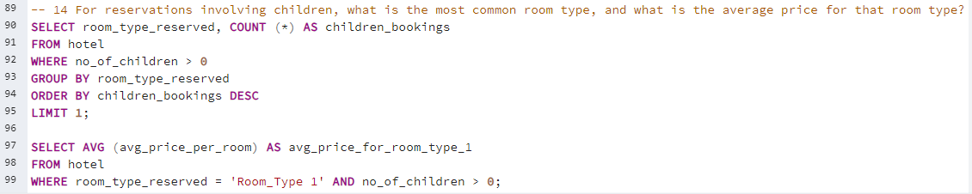


SQL QUERIES
INTRODUCTION
DATA CLEANING
IMPORTING FILES
PROBLEM STATEMENT
SQL QUERIES
CONCLUSION
13. What is the average number of nights (both weekend and weekday) spent by guests for each room
14. For reservations involving children, what is the most common room type, and what is the average

Slide 13
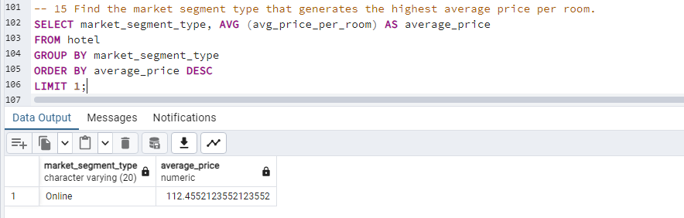

SQL QUERIES
INTRODUCTION
DATA CLEANING
IMPORTING FILES
PROBLEM STATEMENT
SQL QUERIES
CONCLUSION
15. Find the market segment type that generates the highest average price per room.
CONCLUSION

